Slide 1


WELCOME
TO
My presentation
AMITABH

Slide 2
Content
WHAT IS CCTV CAMERA’S
FULL FORM OF CCTV CAMERA’S
TYPES OF CCTV CAMERA’S
ADVANTAGES OF CCTV CAMERA’S
DISADVANTAGES OF CCTV CAMERA’S
APPLICATIONS OF CCTV CAMERA’S
WHAT IS LIMITATION OF CCTV CAMERA’S
IMPORTANCE OF CCTV FOR DATA CENTER SECURITY.
COMPONENTS OF CCTV CAMERA’S SYSTEM.
IMPORTANCE OF CCTV FOR DATA CENTER SECURITY.

Slide 3
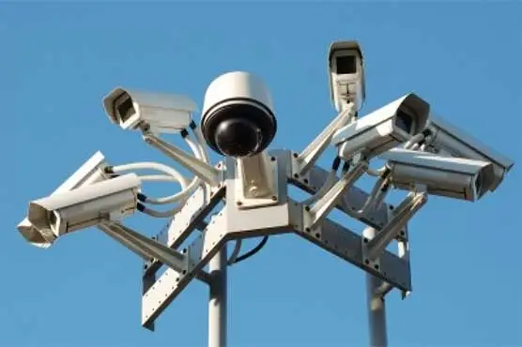
CCTV
What is CCTV cameras called?
Ans:- CCTV relies on strategic placement of camera and private observation of the camera’s input on monitors. The system is called “closed – circuit “ because the camera’s monitors and /or video records communicate across a proprietary coaxial cable run or wireless communication link.

Slide 4
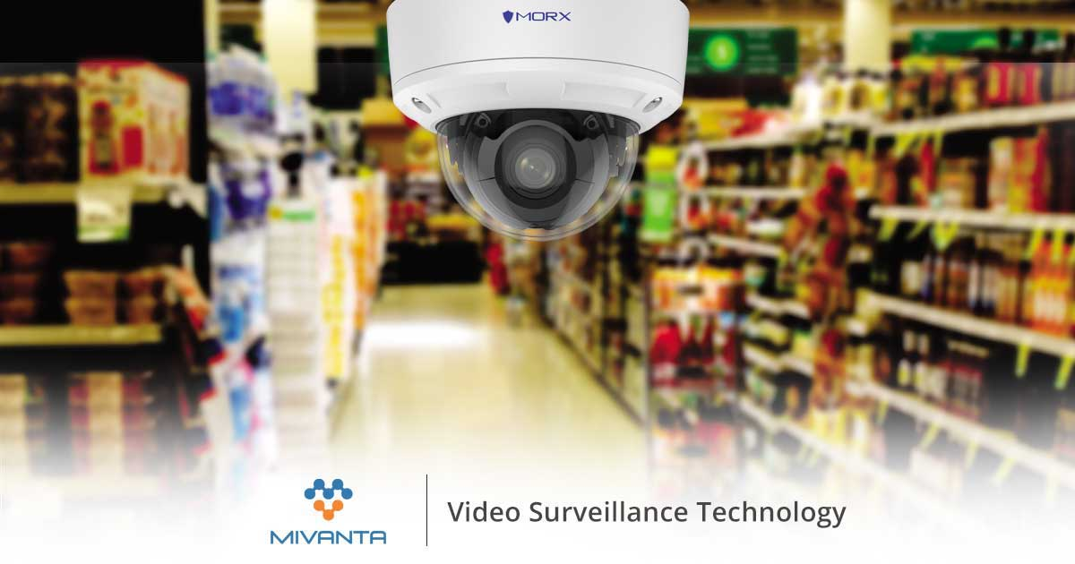
FULL FROM OF CCTV
CCTV ( closed – circuit television )

Slide 5

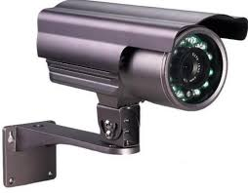
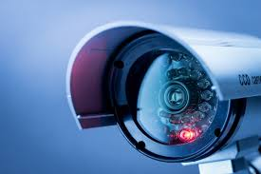
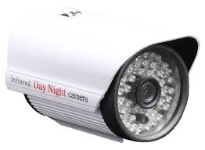
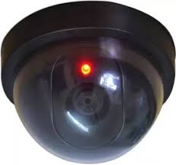
Types of CCTV camera’s
PTZ camera :- PTZ camera allow the camera to be moved left or right (panning) up and down (tilting )and even allow the lens to be.
BULLET CAMERAS :- are long and cylindrical in shape and are ideal for outdoor use. Their strength lie specifically in applications which require long distance.
Hd CCTV CAMERA :- these are analog high definition camera’s which are more modern day in use and technology than analog CCTV camera’s and provide a better resolution.
Day/ night camera: - these cameras can pick up colored images in very low-light conditions . Dark fighter technology can be used in the day ad night.
DOME CCTV :- the dome cameras are named such for their case in which the camera is placed. The greatest advantages of this CCTV is that no one understands their direction the.

Slide 6
ADVANTAGES OF CCTV CAMERAS
Peace of mind
Deterrent and crime prevention
Prosecution
Remote monitoring
Ideal in conjuction with intruder alarms.
Low price high quality.

Slide 7
Disadvantages of cctv cameras
To much expenditure on Appling .
Costly devices.
Difficulty in maintance .
No privacy .
Looking lack of faith.
Too much control on teachers .
No opportunity for teach for professional slowth.
Difficulty of data storage.

Slide 8
WHAT IS LIMITATIONS OF CCTV CAMERA?
Ans:- A joint report by the home office and police found that more than 80% of CCTV pictures are of such poor quality they are no good for police purpose, and most camera are in the wrong places to help in fighting serious crime or terrorism.

Slide 9
Importance of cctv for data center security
Data center hold immense information for business and work as a data repository for modern industries and society. They can provide business with all kinds of data service and seamless access through private servers and the internet.
HOWEVER, the centralization of all this sensitive information means that data centers are a big target for cyber threats and attacks . Cybercriminals and hackers are always looking for ways to access or alter the data stored in data centers illegally.
HENCE, data center security is important safety mechanisms and systems like a cctv system for video surveillance can help resolve many security issues, including unauthorized physical access or tampering .

Slide 10
COMPONENTS OF CCTV CAMERA SYSTEM
Camera if you are building a cctv camera system, you have two camera option internet protocol (IP) or analog.
Monitoring station
Cables and routers
Video recorders
Data storage.

Slide 11
Application of cctv camera’s
Crime management
CCTV surveillance can deter potential criminals. When a crime does occur, video footage can help law enforcement to investigate and later provide evidence for prosecution in a law court. Used in conjunction with CCTV, audio, thermal and other types of sensors can alert officials to occurrences that are out of the ordinary, e.g. a fire or gun shots at a location. For businesses, CCTV cameras can detect and monitor in-house criminal activities.
Disaster management
Using CCTV cameras, emergency services and rescue workers are able to assess and monitor events in real time to relay a “situation” via video to disaster management teams, e.g. from inside a burning building, from a cave or from a helicopter flying over a scene.
Medical monitoring and diagnosis
There are about 43 facial muscles that express people’s thoughts and feelings. Smart software can identify these expressions, e.g. pain or anxiety, from images more easily that people can. CCTV cameras can also monitor patients – for instance children or the elderly – to identify potential medical crises, e.g. a stroke, or an epileptic or asthma attack.
City and community street monitoring
Cameras at traffic lights and elsewhere in cities monitor people to gather traffic statistics as well as evidentiary footage for speeding. An heir to the IoT, the AoT is a Chicago initiative to collect real-time data, primarily weather and environment, about the city

Slide 12
IMPORTANCE OF CCTV FOR DATA CENTER SECURITY
Data centers hold immense information for businesses and work as a data repository for modern industries and society. They can provide businesses with all kinds of data services and seamless access through private servers and the Internet.
However, the centralization of all this sensitive information means that data centers are a big target for cyber threats and attacks. Cybercriminals and hackers are always looking for ways to access or alter the data stored in data centers illegally.
Hence, data center security is important. Safety mechanisms and systems like a CCTV system for video surveillance can help resolve many security issues, including unauthorized physical access or tampering.

Slide 13


THANKYOU

